Slide 1
The Blue Green Infrastructure Training Programme
How do we provide stakeholders with the ‘green’ skills to manage flood risk effectively and address the challenges of climate change?
Ryan Urquhart (iCASP) and Mark Wilkinson (Environment Agency)

Slide 2
The Blue Green Infrastructure Training Programme
WY FLIP Board identified skills as a risk to delivery
SuDS
Green skills associated with Climate Resilience & Readiness
Received YRFCC Local Levy funding
What does the programme look like?
Led by iCASP
Yorkshire wide
Work with wide-range of organisations
Carry out a focussed skills audit
Develop and deliver a training programme

Slide 3
The Blue Green Infrastructure Training Programme
What will it deliver?
Understanding of skills gap (SuDS and Green Skills)
Programme of work – priority training packages to benefit teams across the region
Hub for training
Upskilling / empower
Share with others / a template for the future?
What have we done so far?
Funding approved Summer 2023
Set up a Project Steering Group
Gathered information to feed into skills audit
Delivered skills audit, and collated the data to inform the training packages

Slide 4
The Blue Green Infrastructure Training Programme
Training Needs Analysis survey overview
Completed in Summer 2024
Targeted at Flood Risk Authorities and Risk Management Authorities across Yorkshire
Participants asked responses across 35 questions
90 complete responses in total
What was asked?
Questions gathered data on training needs across NFM, SuDs, general green skills and project management.
Free text responses
Captured if the person responding had any organisational/managerial responsibilities

Slide 5
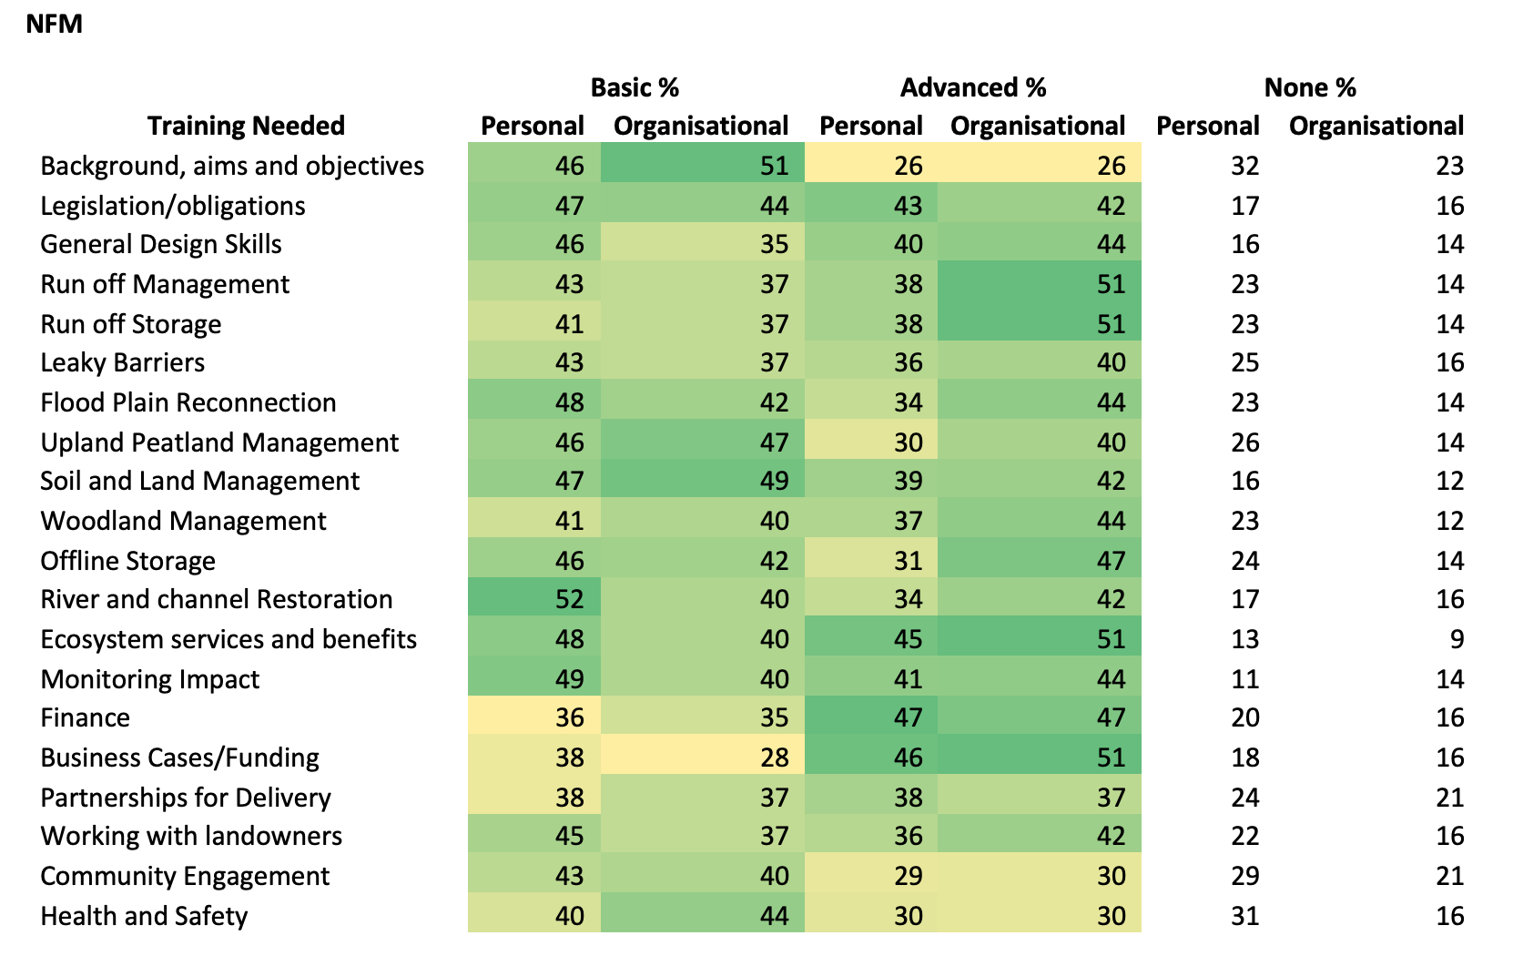
Understanding Demand (1)
Provides a good picture of where training is required.
Personal vs. organisational responses
Some areas e.g. Run off topics are clearly something respondents require training in
No ‘clear’ pattern (when compared with results for SuDs)
51% of respondents with organisational responsibility say they require ‘basic’ training in the aims and objectives of NFM.
Indicates the % of respondents that require training.

Slide 6
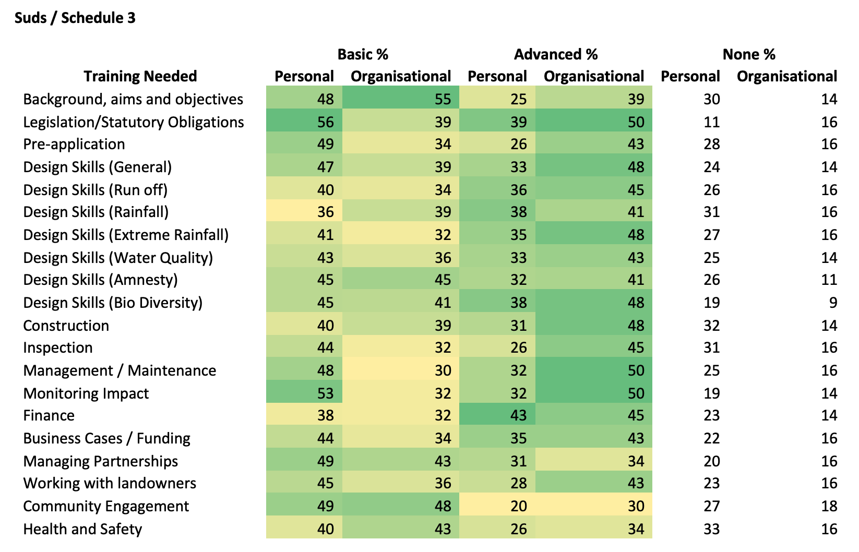
Understanding Demand (2)
55% of response organisations require basic training on what this is and the objectives
Much clearer pattern however that they are not currently equipped for this – greater demand for advanced and comprehensive training in this area.
Indicates the % of respondents that require training.

Slide 7
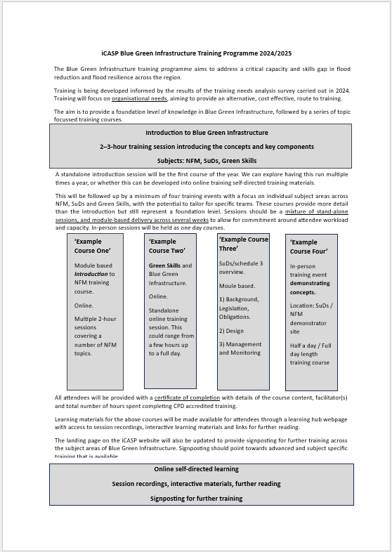
The Blue Green Infrastructure Training Programme
Produce high quality training developed and delivered by academics and researchers:
People who are knowledgeable and passionate about the subject who are keen to contribute building capacity in the region.
An introduction to Blue Green Infrastructure
Training courses across NFM/SuDs/Green Skills.
Certificates of completion
An online hub for post-course learning materials.
Signposting to further training.

Slide 8
The Blue Green Infrastructure Training Programme
More Information and Contact Info
I’ll be available all day throughout the breaks with more outputs of the skills analysis survey and for queries.
https://icasp.org.uk/scrimp-skills-capacity-and-resilience-improvement-programme/
Email: r.j.Urquhart@leeds.ac.uk / georur@leeds.ac.uk

