Slide 1
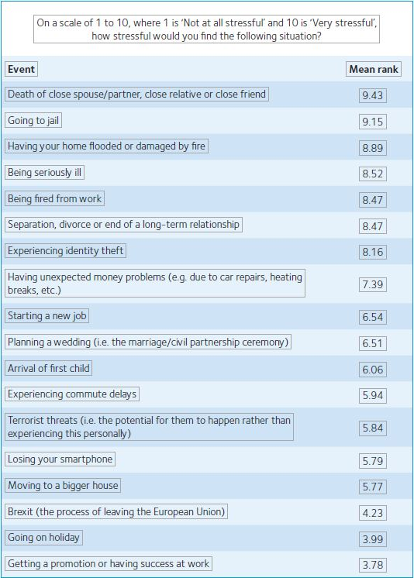
Mental Health and Wellbeing Project
Stressed-out Britain? A report on our annual Theme and our survey - https://www.physoc.org/magazine-articles/stressed-out-britain-a-report-on-our-annual-theme-and-our-survey/

Slide 2
Project Aim
to improve mental health, wellbeing and flood resilience in high-risk communities
Development Phase
Community and Voluntary Sector Theme

Slide 3
Update
Funding secured
Developing the Business Case for future funding
Developing the Need Assessment
Psychological First Aid Training

Slide 4
Business Case and Future Funding
Local Levy funding secured and additional Kirklees contribution
Partnership funding – research and academic support
Funding being used to develop a strong business plan and funding bid
Esme Fairburn and National Lottery
More Community focused funding pots – the voice of the community

Slide 5
Need Assessment
What is happening in our communities?
What do our communities want?
Questionnaires
Interviews
Wellbeing Professionals
And existing data
Support the future funding bid + Tailoring the Future Project

Slide 6
The Current Picture
Is flooding having/had an impact on the mental health of residents?
Are residents accessing help they need?
Do the residents know how to access support?
What are the barriers residents are facing to access help?

Slide 7
What do communities want?
What can the council do to improve the situation?
What would communities want to help improve mental health & wellbeing in relation to flooding & other risks?
Which wellbeing events/groups could help support them?
Help us to break down barriers

Slide 8
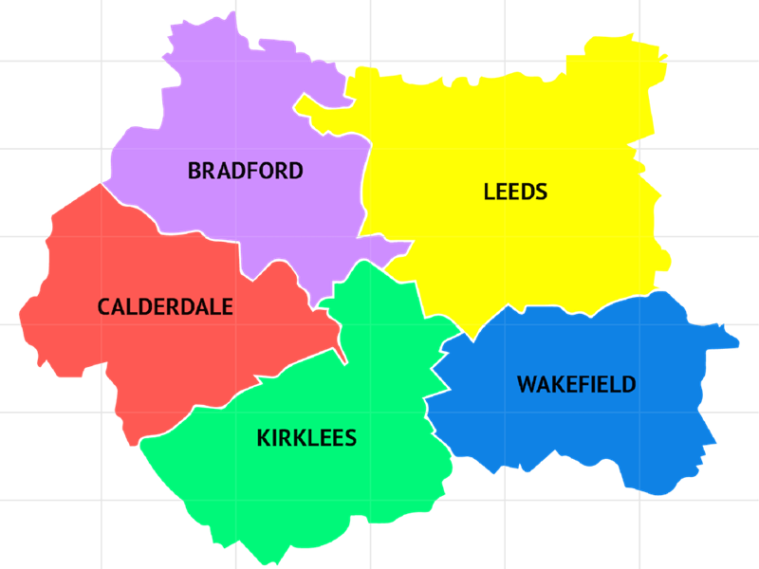
Questionnaires to target all West Yorkshire
This will include an invite to take part in an interview
Currently interviews will only be done in the Kirklees area

Slide 9
Psychological First Aid Training
Psychological first aid is a technique designed to reduce the occurrence of post-traumatic stress disorder

Slide 10
Flood Spotter Collaboration
50+ Community First officers/flood spotters
CCTV operators
Gully wagon drivers
Trained in PFA
Provide information on flood resilience
Can signpost to mental health services

Slide 11
Mental Health and Wellbeing Project
Thank You
Kirklees Council – Flood Management Team
Jason.hanks@kirklees.gov.uk

