Slide 1



SMES AND FLOODING
BRIDGING THE KNOWLEDGE GAP TO BOOST SME FLOOD RESILIENCE
Dr Paola Sakai
UKRI Research and Innovation Fellow
Confluence
8th June, 2021

Slide 2
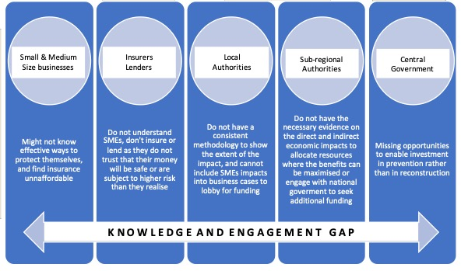
Project aims & objectives

Slide 3
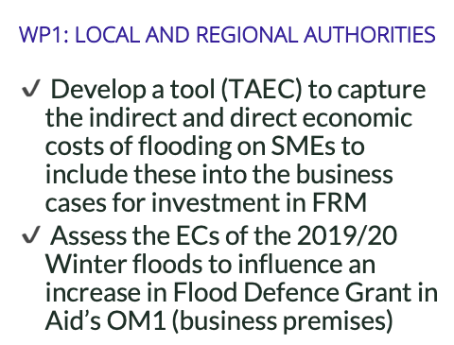
TAEC
Tool to Assess Economic Costs

Slide 4
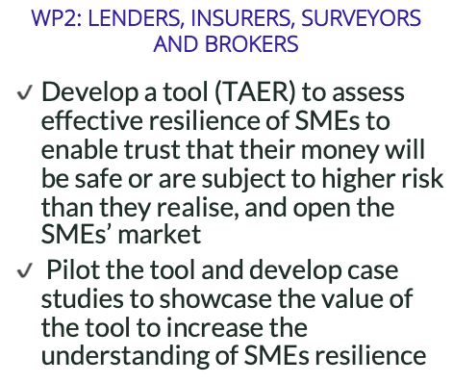
TAER
Tool to Assess Effective Resilience

Slide 5

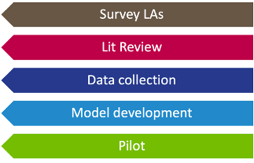
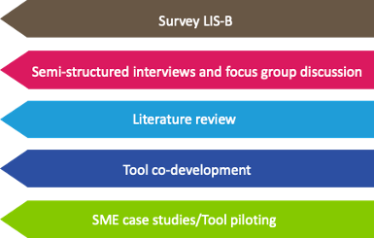
Tools development process
Tool to Assess Economic Costs
Tool to Assess Effective Resilience

Slide 6

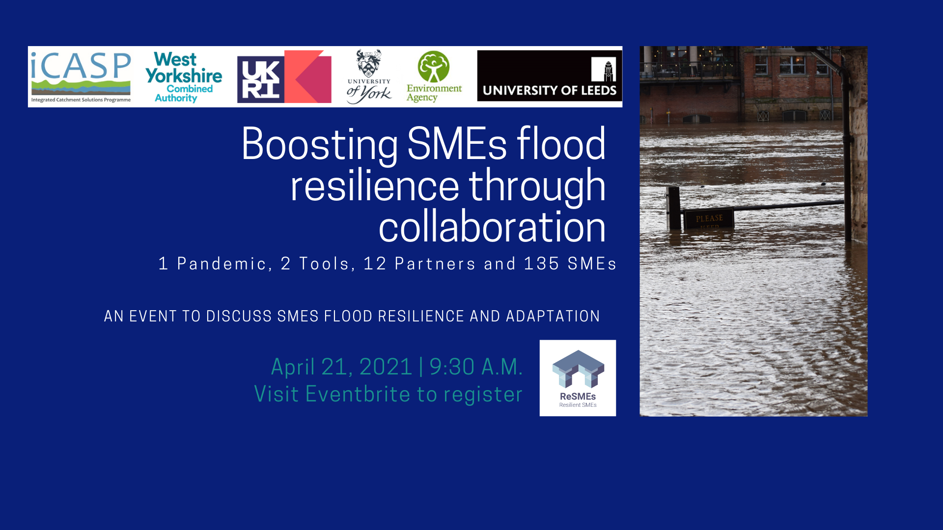
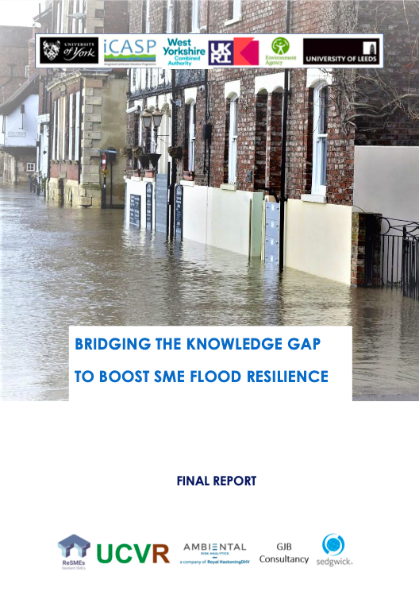

https://www.eventbrite.co.uk/e/boosting-smes-flood-resilience-through-collaboration-tickets-146938957377

Slide 7

Dr Paola Sakai P.H.M.D.Oca@Leeds.ac.uk
@PaolaSakai
@SMEResilienceUK
@SMEsandFloodResilience

