Slide 1

Peatlands and benefits of their restoration
This is a template ppt presentation for running Part B - phase 4 of the Deliberative Monetary Valuation protocol.
This should be adapted depending on the sample population and interest of the valuation

Slide 2
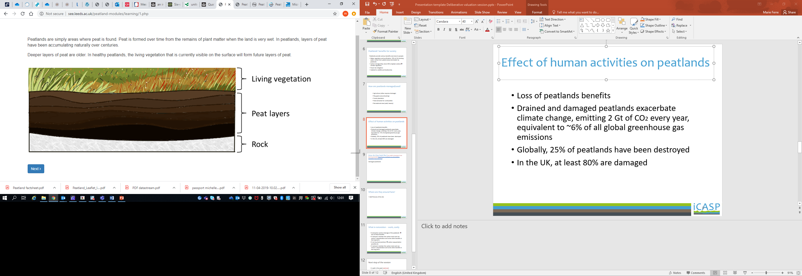

What are peatlands
Peatlands are wet ecosystems characterized by a first layer of peat (>30cm) that formed through accumulation of organic matter over millenia, and specific vegetation
      Source: http://www.see.leeds.ac.uk/peatland-modules/learning/1.php
Two main types of peatland: Bogs are fed by rainfall water, fens are waterlogged through groundwater
Notes:
http://www.iucn-uk-peatlandprogramme.org/sites/www.iucn-uk-peatlandprogramme.org/files/1-10%20Peatland%20Briefings%20-%205th%20November%202014.pdf

Slide 3
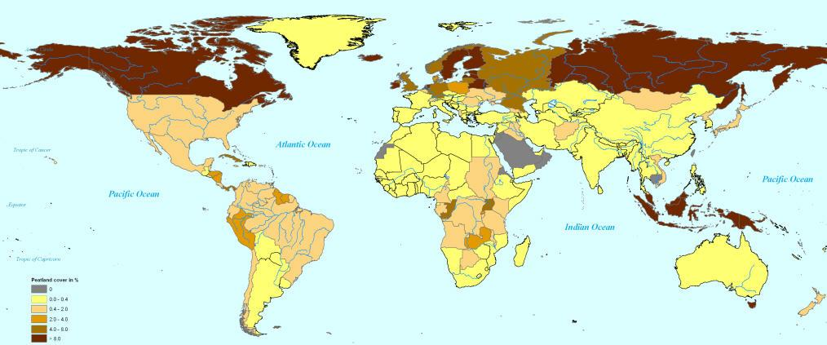
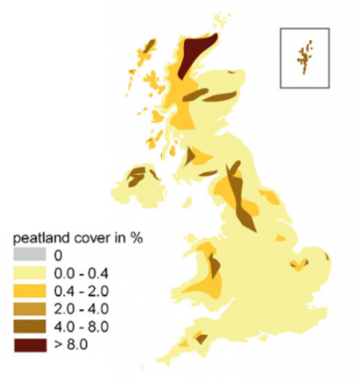
Where are they located (slide to be adapted depending on valuation interest: if a local site, then need to prioritise on local peatlands)
Global distribution of peatlands - https://bogology.org/2014/04/11/around-the-world-in-80-peatlands/
Peatlands cover ~ 3% of the world’s land area, and 12% of UK’s land area
Distribution of peatlands in the UK; IUCN - https://www.iucn-uk-peatlandprogramme.org/about-peatlands/uk-peatlands
Notes:
You could add surface figures for the region you are focusing on, if this is the case

Slide 4
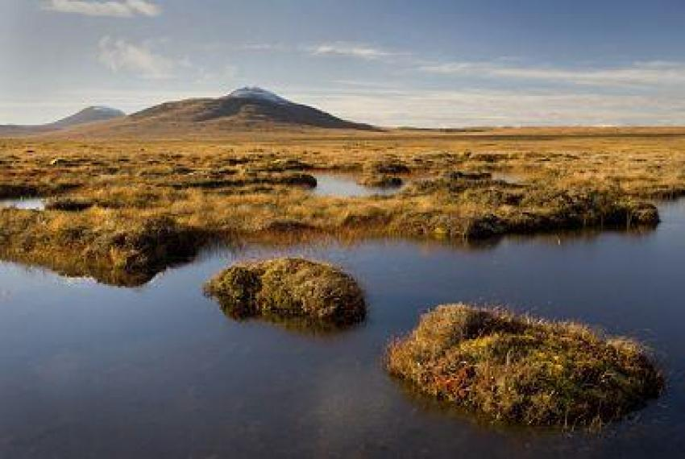
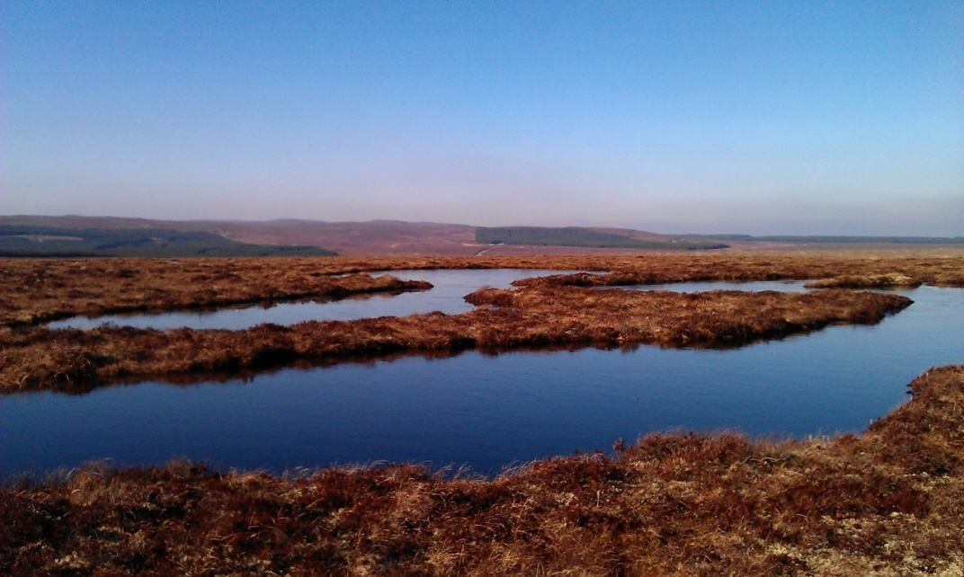
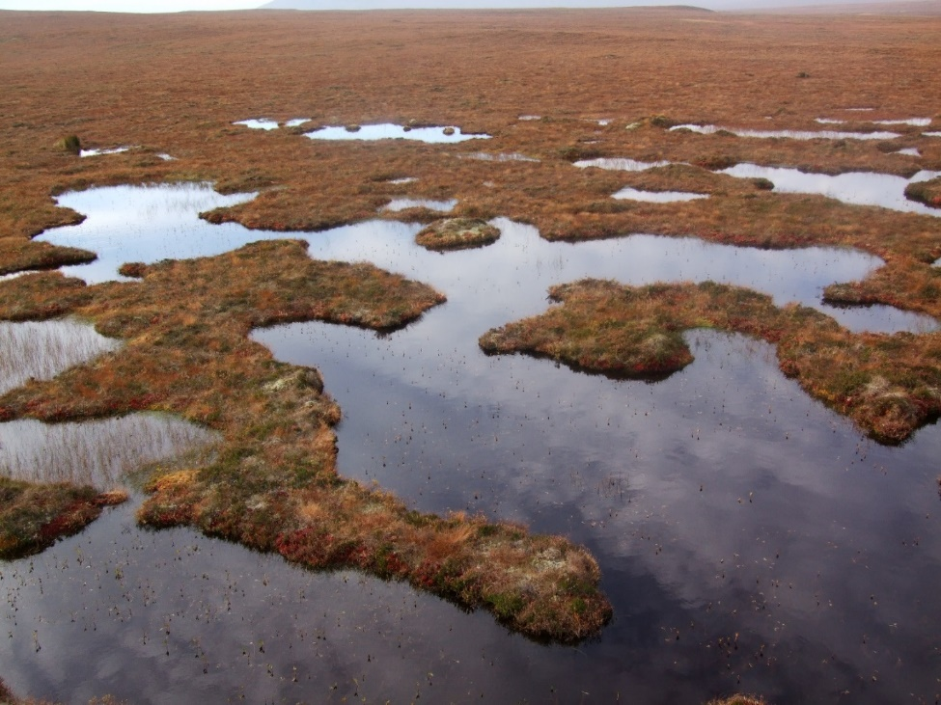
What do they look like
Source: IUCN
Pools of water on UK blanket peat
Photo credit: Joseph Holden
Pools of water on UK blanket peat
Photo credit: Joseph Holden
Notes:
UK peatlands

Slide 5
What do they look like (cont.)
You may want to add your own pictures, or pictures specific to a local site that you are interested in (if valuation considers that site specifically)

Slide 6
Peatlands’ benefits for society
Peatlands provide various benefits (services) to people:
Water regulation and purification: 70% of UK drinking water comes from upland areas dominated by peatlands
Carbon storage (they store 30% of global carbon)→ climate regulation
Habitat for wildlife and biodiversity
Flood risk mitigation
Notes:
Source: IUCN

Slide 7
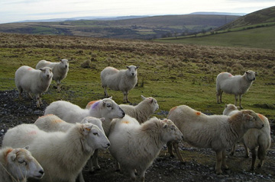
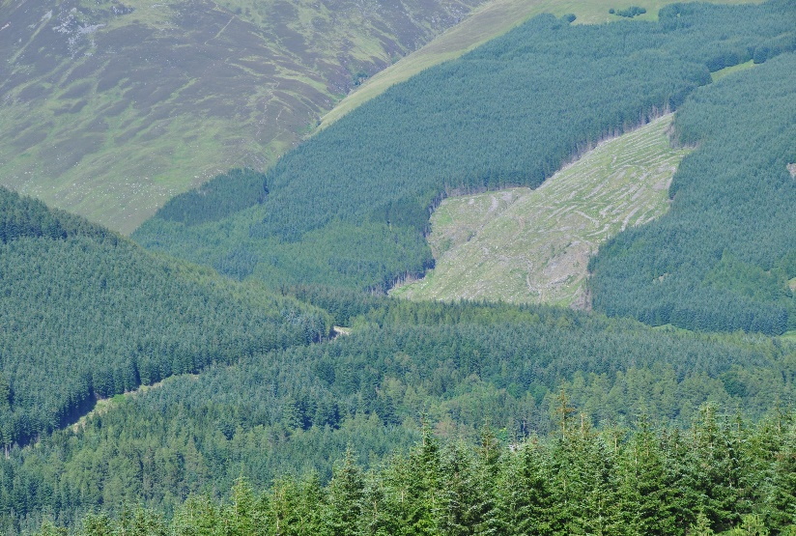
How are peatlands managed?
Agriculture: cultivation, grazing
Shooting area
Forest plantation
Extraction of peat for combustible
Recreational area
Source: http://www.see.leeds.ac.uk/peatland-modules/learning/3.php
Notes:
Historical use of peatlands.

Slide 8
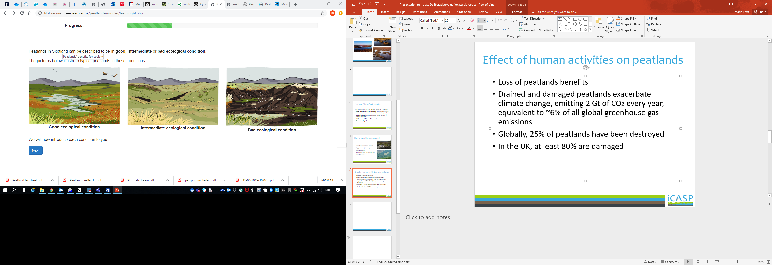
Effect of human activities on peatlands
Loss of peatlands benefits
Carbon emissions: drained & damaged peatlands exacerbate climate change, emitting 2 Gt of CO₂ every year, equivalent to ~6% of all global greenhouse gas emissions
Globally 25% of peatlands have been destroyed; in the UK 80% are damaged
Source: http://www.see.leeds.ac.uk/peatland-modules/learning/4.php
Notes:
Reduced water quality, can no longer support wildlife.

Slide 9
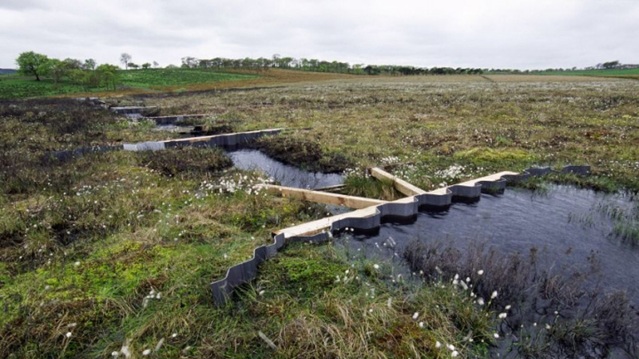
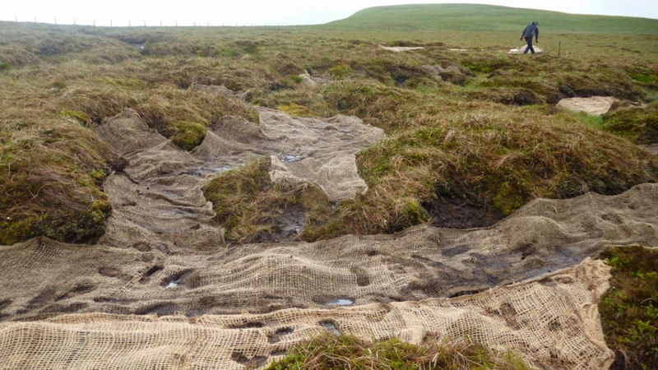
What is restoration
Rewet site, stabilise soil to restore conditions for peat to grow again
Source: http://www.see.leeds.ac.uk/peatland-modules/learning/15.php

Slide 10
Restoration work
Add pictures of people doing restoration work
Restoration is costly: ~£1000/ha (Okumah et al. 2019)
Add more information on costs and any other relevant info. on that
Notes:
Source: Okumah et al. 2019: How much does peatland restoration cost: insights from the UK

Slide 11
Effect of restoration
Maintain the carbon stock
Restore process of carbon sequestration in the long term → mitigate the effect of climate change
Restore capacity to purify and regulate water
Support wildlife and biodiversity

Slide 12
Open discussion
Which aspect of the presentation interests you the most?
Did you learn anything (about peatlands) that you did not know before?
What is your fondest memory of a peat site visit?
What was the main thought you had while visiting the site?

